Slide 1
Quantum Neural Network Compression
Zhirui Hu¹, Peiyan Dong², Zhepeng Wang¹, Youzuo Lin³, Yanzhi Wang², Weiwen Jiang¹
¹ George Mason University
² Northeastern University
³ Los Alamos National Laboratory

Slide 2
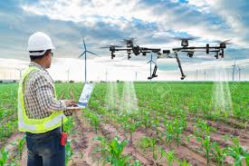
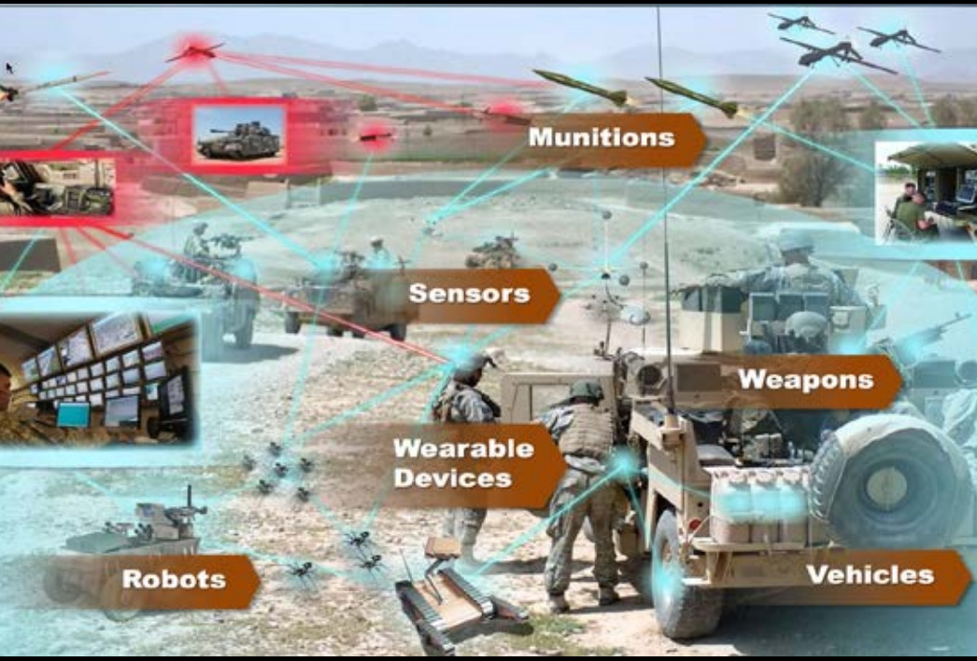

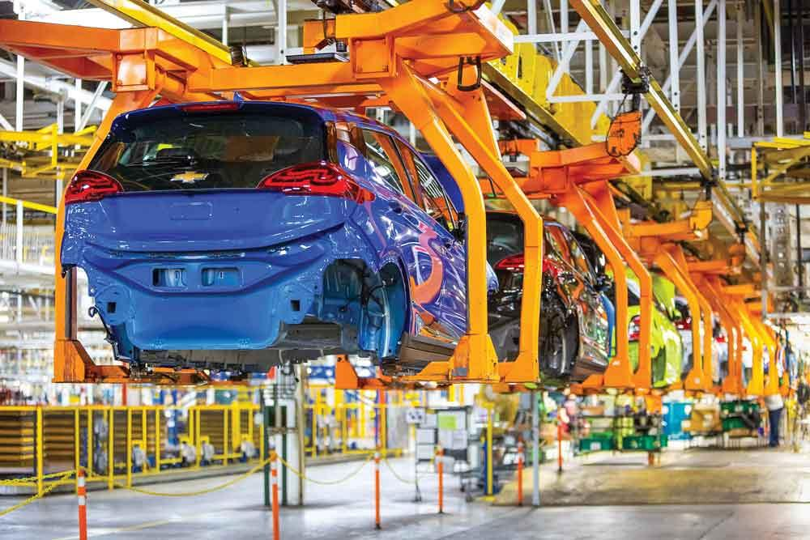

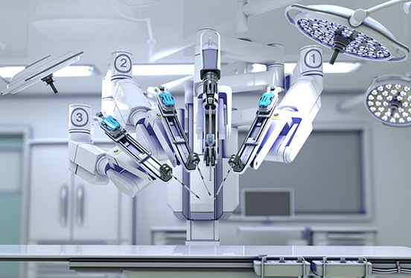
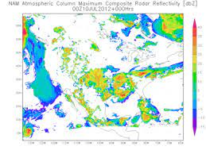
Why Learning?
Agriculture
Military
Power System
Manufacture
Education
Medical Operation
Scientific Computing
……

Slide 3
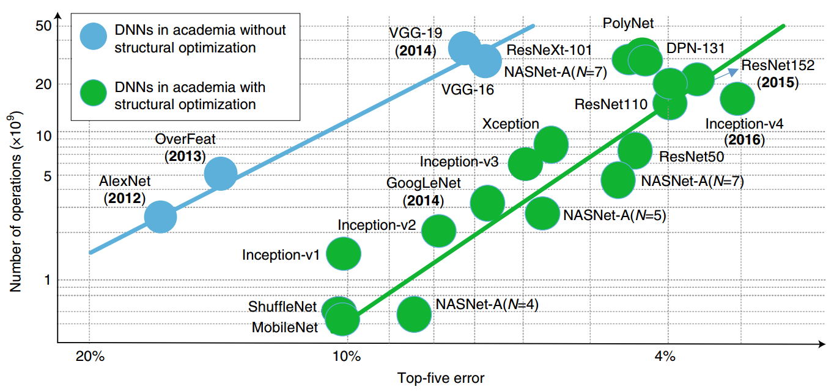
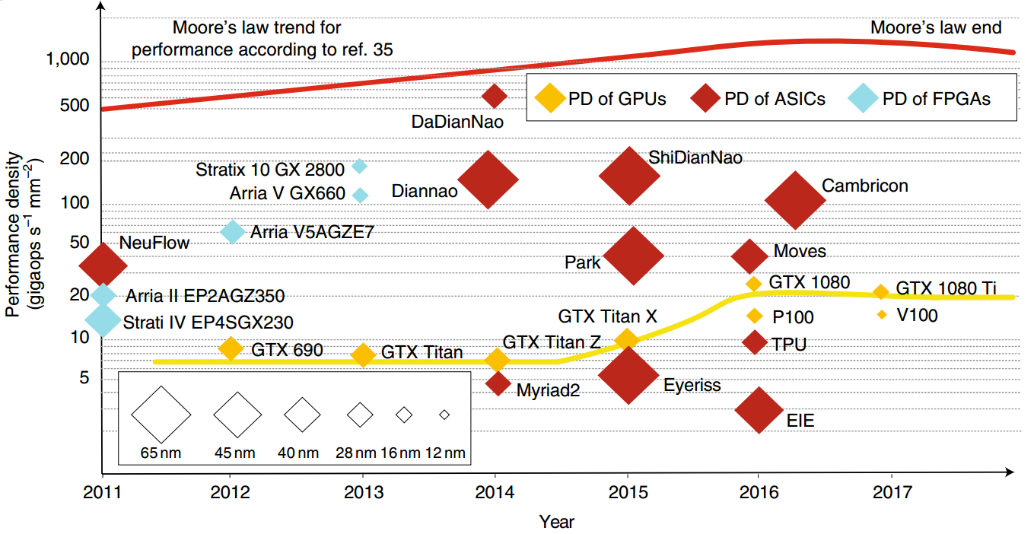
Bottlenecks in Classical Computing
Deep neural network grows exponentially
Perf. of classical computing stops increasing
Medical AI Scenario: (Input size exponentially grows from Radiology to Pathology Imaging)
Radiology Imaging
Pathology Imaging
Radiology Modality | Avg. Size (MB)
CT Scan | 153.4
MRI | 98.6
X-ray angiography | 157.5
Ultrasound | 69.2
Breast imaging | 38.8
Biopsy Type | Compressed Size(MB)/Study | Original Size (GB)
Dermatopathology | 1,392 (20x compression) | 27
Head and neck | 1,965 (20x compression) | 38
Hematopathology | 40,300 (40x compression) | 1574
Neuropathology | 1,872 (20x compression) | 37
Thoracic pathology | 3,240 (20x compression) | 63
[ref] Lauro, Gonzalo Romero, et al. "Digital pathology consultations—a new era in digital imaging, challenges and practical applications." Journal of digital imaging 26.4 (2013).

Slide 4

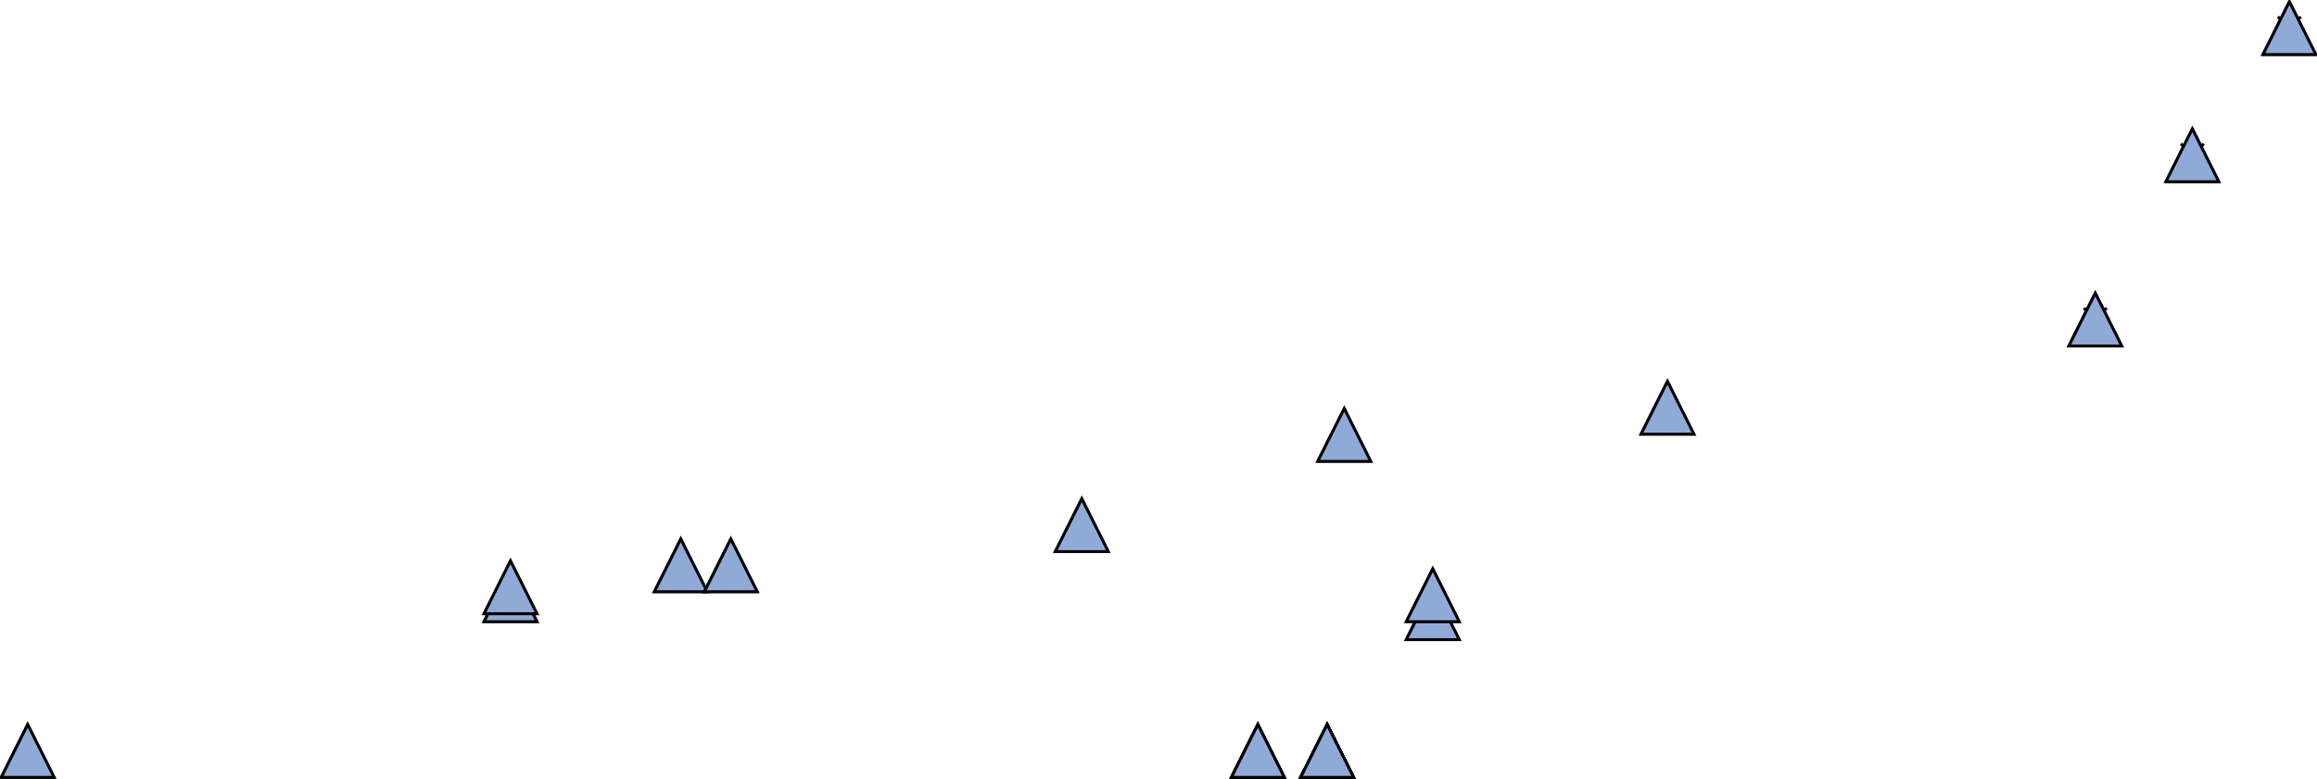
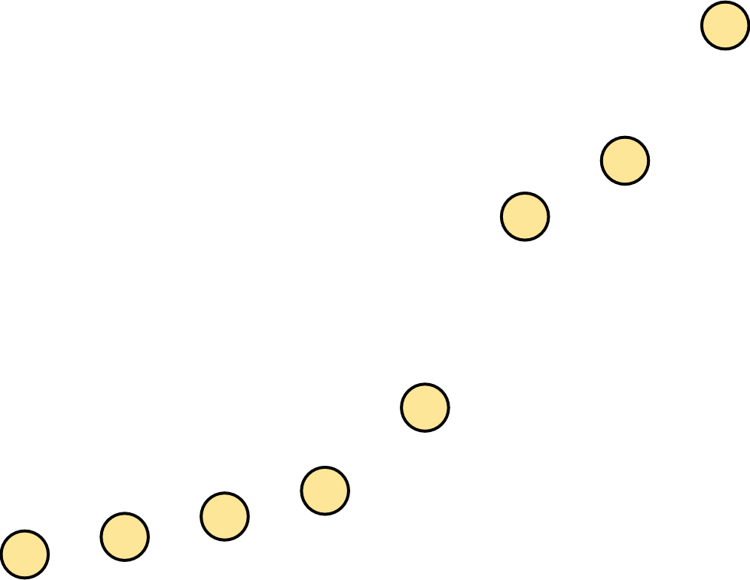


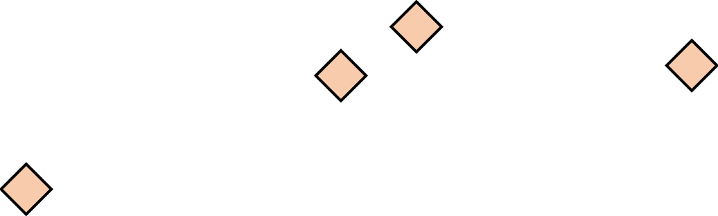
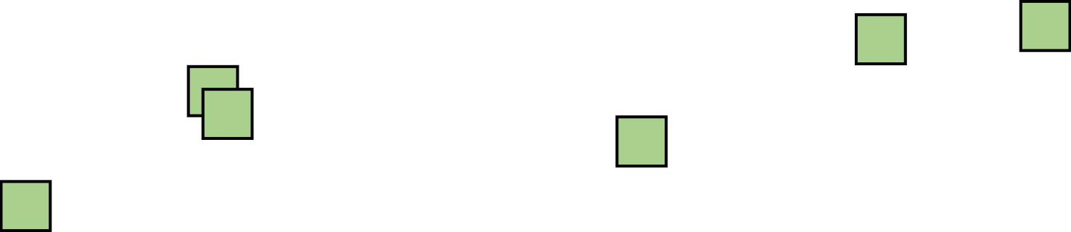
Impossible in Classical But Possible in Quantum Computing
2
0
4
8
1
0
2
4
5
Eagle Processor
(127 Qubits)
Nov. 15, 2021
1
2
2
5
6
1
The capacity of Classical Simulation
2
8
6
4
47 qubits
3
2
1
6
8
4
2
1
2
0
2
2
2
6
4
2
0
2
04/
0
8
2
0
1
5
05
2
0
1
6
06
2
0
1
7
07
2
0
1
8
08
2
0
1
9
09
2
0
2
0
10/
2
0
2
/
/
/
/
/
1
The maximum qubits that supercomputers can simulate for arbitrary circuits is less than 47 qubits.
Summit w/ 2.8 PB memory for 47 qubits; (2) Sierra w/ 1.38 PB memory for 46 qubits;
(3) Sunway TaihuLight w/ 1.31 PB memory for 46 qubits; (4) Theta w/ 0.8 PB memory for 45 qubits.
[ref] Wu, Xin-Chuan, et al. "Full-state quantum circuit simulation by using data compression." Proceedings of the International Conference for High Performance Computing, Networking, Storage and Analysis. 2019.

Slide 5

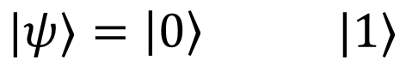

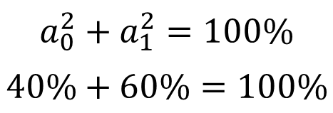
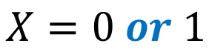
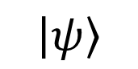
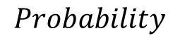
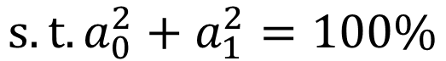
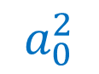
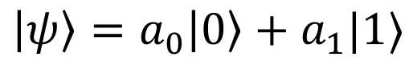
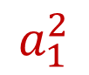
The Power of Quantum Computers: Qubit
Reading out Information from Qubit (Measurement)
Classical Bit
$$X=0 or 1$$
0
$$a_{0}^{2}$$
$$0$$
0
1
Quantum Bit (Qubit)
$$\left|ψ\right\rangle$$
1
and
$$a_{1}^{2}$$
$$1$$
$$|ψ⟩=\left|0\right\rangle |1⟩$$
𝑁𝑜𝑛−𝐷𝑒𝑡𝑒𝑟𝑚𝑖𝑛𝑖𝑠𝑡𝑖𝑐 𝐶𝑜𝑚𝑝𝑢𝑡𝑖𝑛𝑔
$$Probability$$
$$\left|ψ\right\rangle =a_{0}\left|0\right\rangle +a_{1}|1⟩$$
$$a_{0}^{2}+a_{1}^{2}=100\%$$
$$40\%+60\%=100\%$$
$$s.t. a_{0}^{2}+a_{1}^{2}=100\%$$

Slide 6
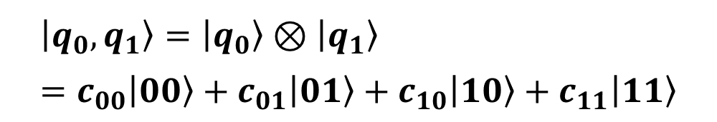
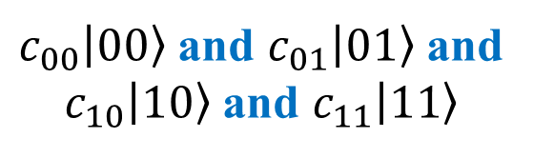

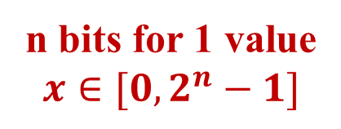
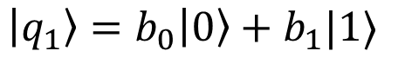
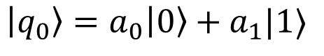
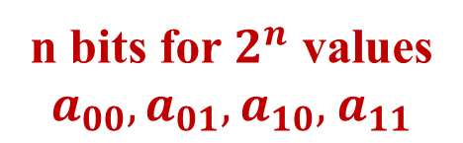
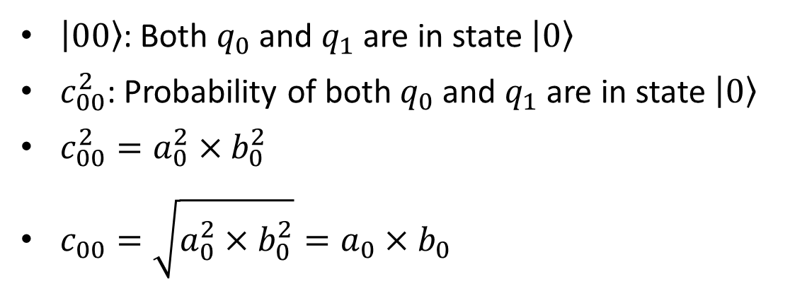
The Power of Quantum Computers: Qubits
2 Classical Bits
Qubits: $q_{0}$, $q_{1}$
00 or 01 or 10 or 11
$$\left|q_{0}\right\rangle =a_{0}\left|0\right\rangle +a_{1}|1⟩$$
n bits for 1 value
$$x∈[0,2^{n}−1]$$
$$\left|q_{1}\right\rangle =b_{0}\left|0\right\rangle +b_{1}|1⟩$$
$$\left|q_{0},q_{1}\right\rangle =\left|q_{0}\right\rangle ⊗\left|q_{1}\right\rangle =c_{00}\left|00\right\rangle +c_{01}\left|01\right\rangle +c_{10}\left|10\right\rangle +c_{11}\left|11\right\rangle$$
2 Qubits
$\left|00\right\rangle$: Both $q_{0}$ and $q_{1}$ are in state $\left|0\right\rangle$
$c_{00}^{2}$: Probability of both $q_{0}$ and $q_{1}$ are in state $\left|0\right\rangle$
$c_{00}^{2}=a_{0}^{2}×b_{0}^{2}$
$c_{00}=\sqrt{a_{0}^{2}×b_{0}^{2}}=a_{0}×b_{0}$
$c_{00}\left|00\right\rangle$ and $c_{01}\left|01\right\rangle$ and
$c_{10}\left|10\right\rangle$ and $c_{11}\left|11\right\rangle$
n bits for $2^{n}$ values
$a_{00},a_{01},a_{10},$ $a_{11}$

Slide 7


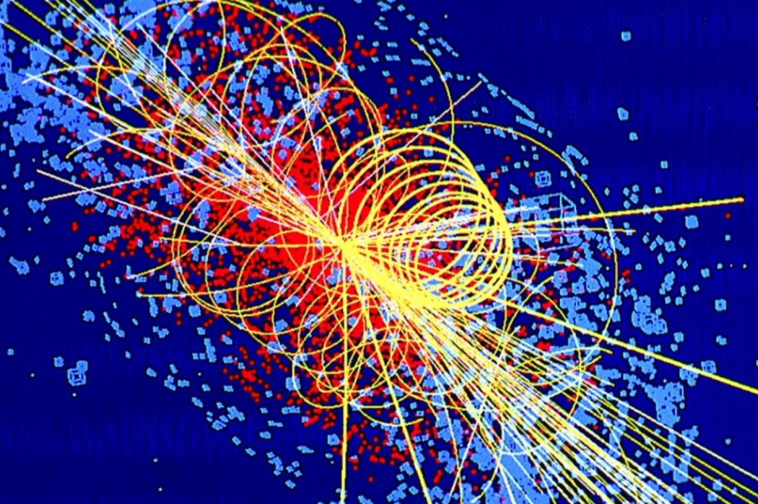
Why Quantum ML? --- Promising in Many Applications.
Drug Discovery
Finance
Physics Simulation

Slide 8

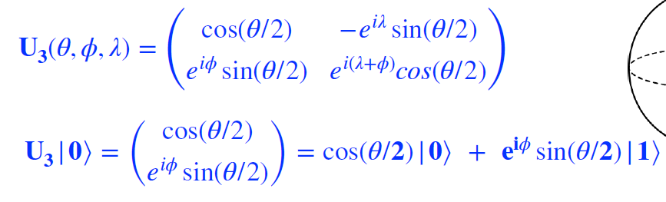
What is QML? --- General U Gates
Single-Qubit Gates
Pauli operators: X, Y, Z Gates
Hadamard gate: H Gate
General gate: U Gate

Slide 9
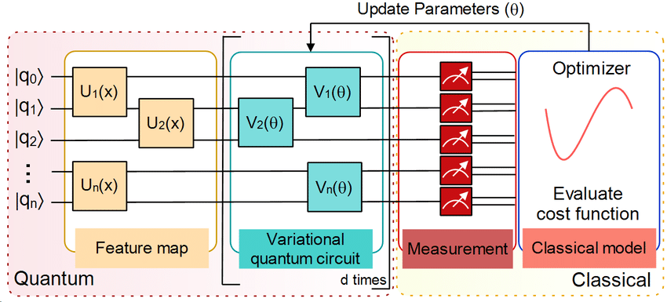
What is QML? --- Variational Quantum Circuit
[ref] Sen, P., Bhatia, A.S., Bhangu, K.S. and Elbeltagi, A., 2022. Variational quantum classifiers through the lens of the Hessian. Plos one, 17(1), p.e0262346.

Slide 10


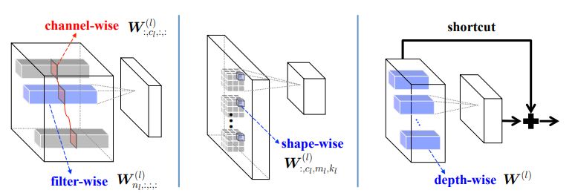
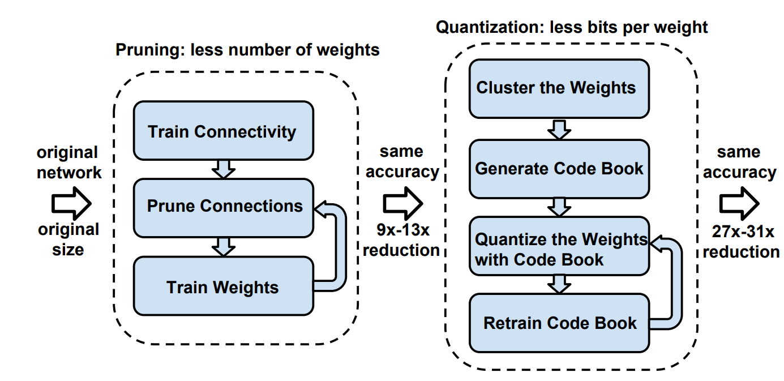
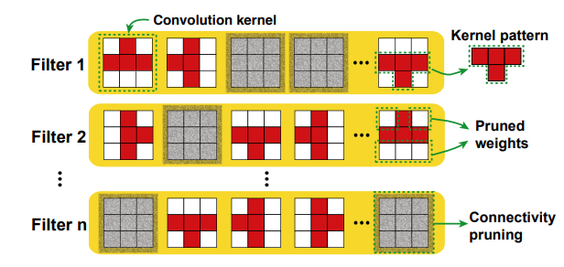
Why Compression in Classical NN?
Real-time Performance
Storage Bottleneck
[ref 1] Han, Song, Huizi Mao, and William J. Dally. “Deep compression: Compressing deep neural networks with pruning, trained quantization and huffman coding.”, 2015.
[ref 2] Wen, Wei, et al. "Learning structured sparsity in deep neural networks." Advances in neural information processing systems 29 (2016).
[ref 3] Ma, Xiaolong, et al. "Pconv: The missing but desirable sparsity in dnn weight pruning for real-time execution on mobile devices." Proceedings of AAAI. Vol. 34. No. 04. 2020.

Slide 11
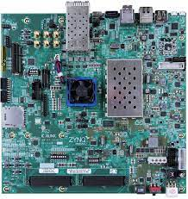
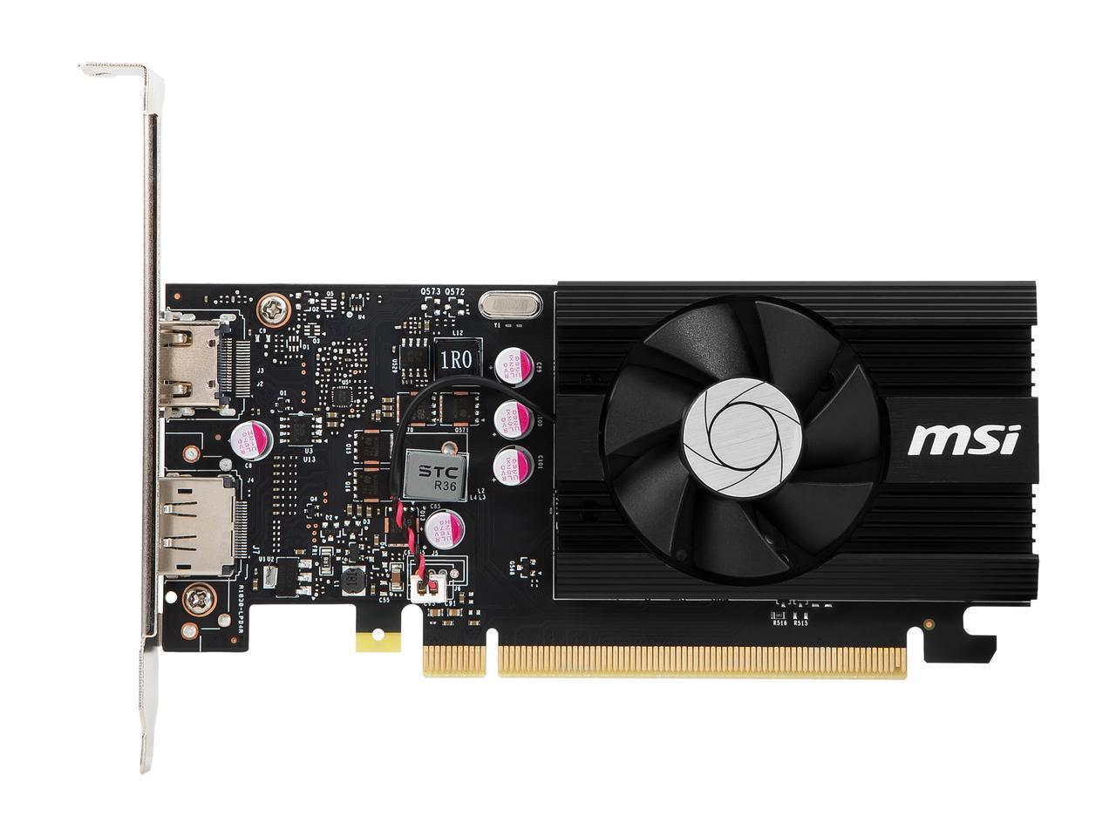
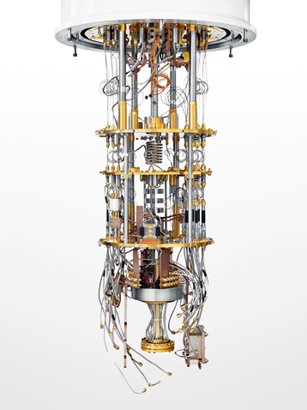
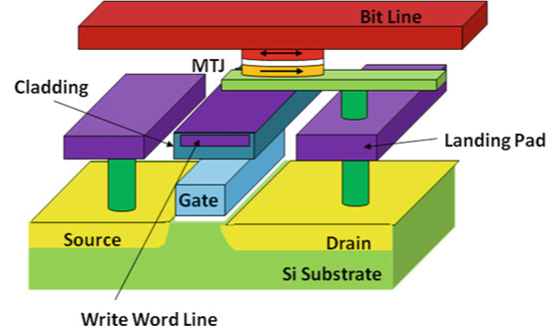
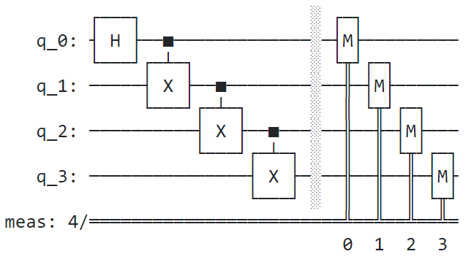
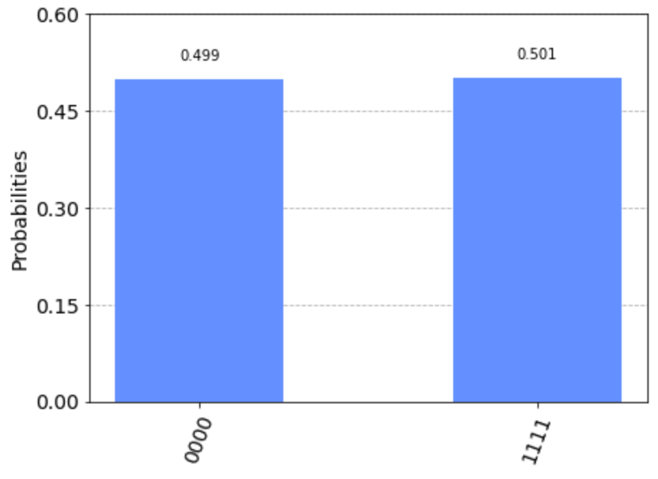
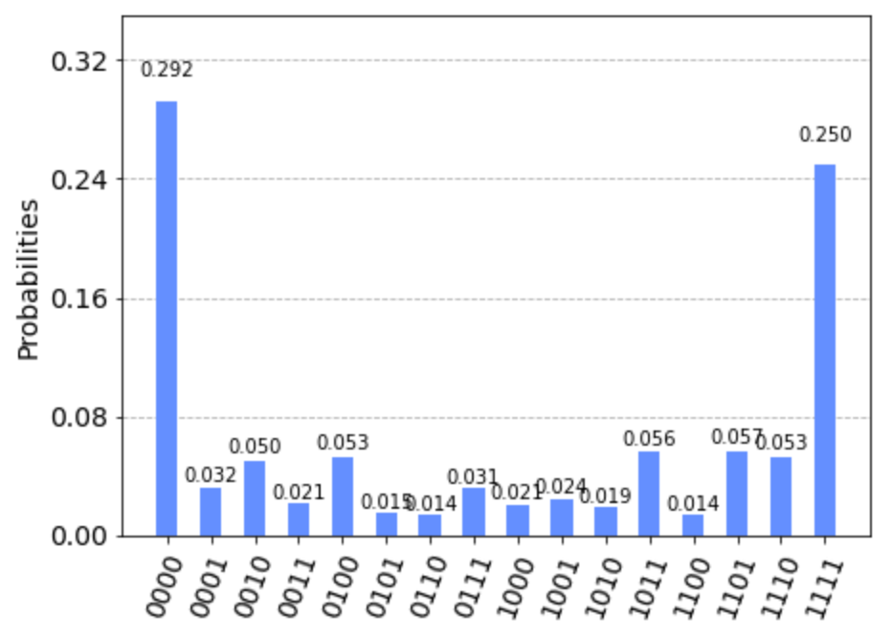
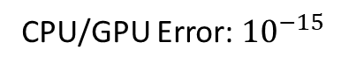
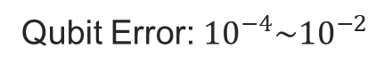
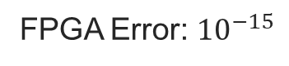
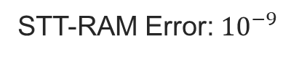
Why Compression in Quantum NN?
?
FPGA Error: ${10}^{−15}$
CPU/GPU Error: ${10}^{−15}$
STT-RAM Error: ${10}^{−9}$
Qubit Error: ${10}^{−4}\sim {10}^{−2}$
Ideal Results
Results w/ Bit-Flip Error

Slide 12
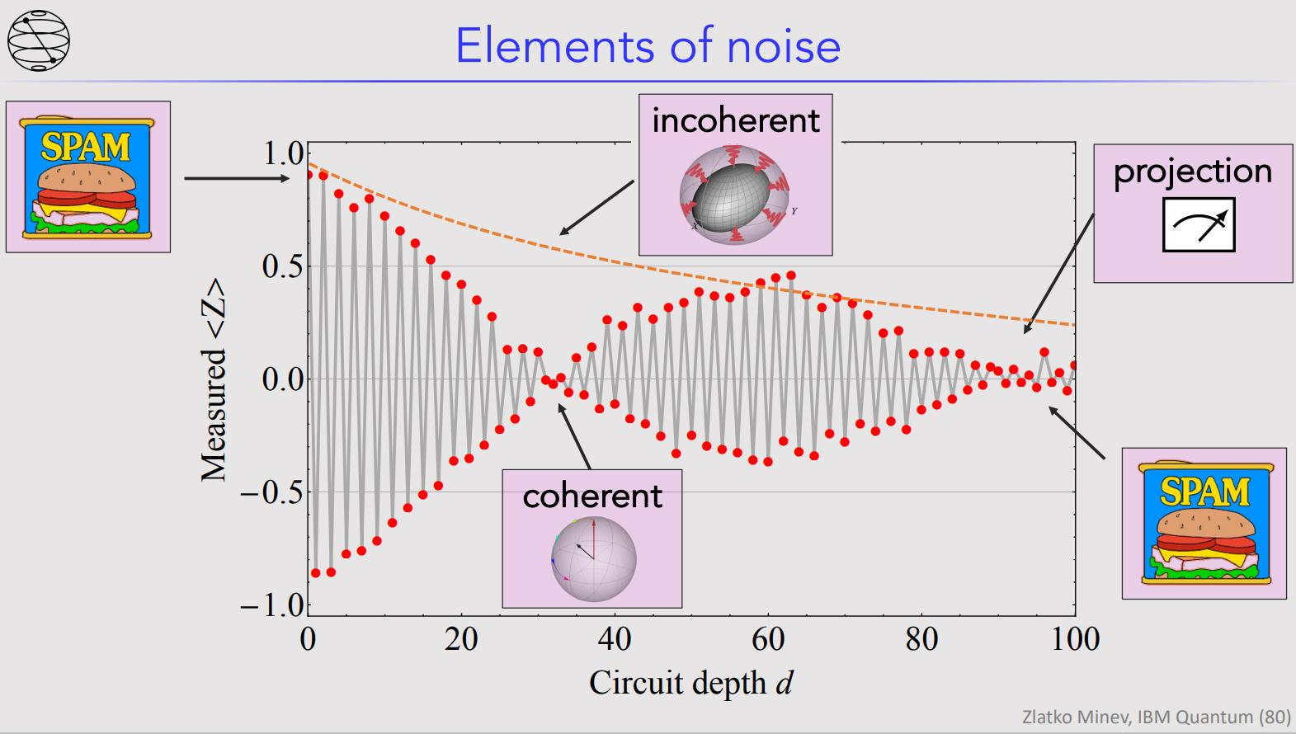
Why Compression in QNN? --- Circuit Depth Affects Performance under Noisy Env.
Ref: Zlatko K. Minev, IBM Quantum .

Slide 13
Outline
Observation
Framework
LUT Construction and Training a Quantum Model
Problem Definition
Reconstruct LUT For ADMM
Compression based on ADMM
Deployment
Experiments
Conclusion

Slide 14
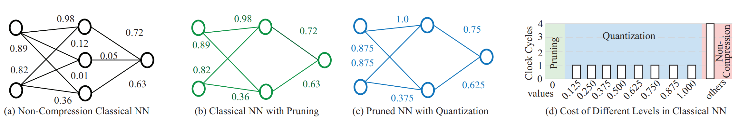
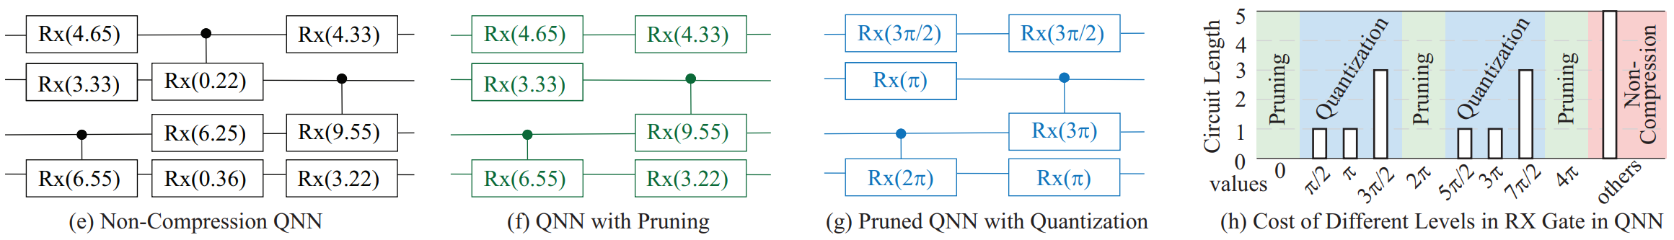
Motivation and Background: From Classical To Quantum
Pruning and Quantization in Classical ML
Pruning and Quantization in Quantum ML
Pruning: Not only 0 can be pruned, but also 2pi, 4pi, etc.
Quantization: Different quantization level may have different cost

Slide 15
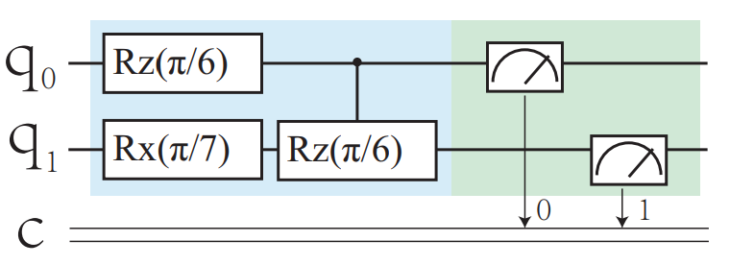
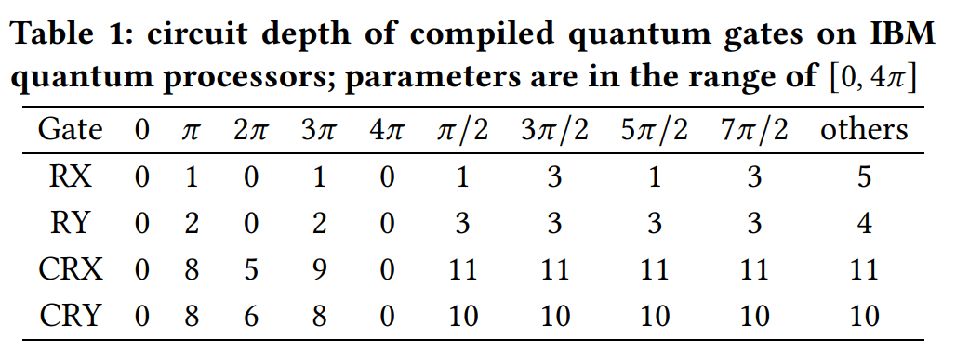
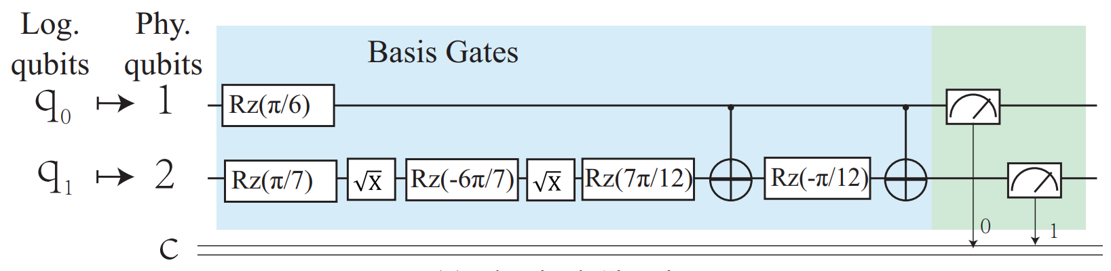
Motivation and Background : Quantum Compression is Compilation Aware
Compilation

Slide 16
Outline
Observation
Framework
LUT Construction and Training a Quantum Model
Problem Definition
Reconstruct LUT For ADMM
Compression based on ADMM
Deployment
Experiments
Conclusion

Slide 17

CompVQC
LUT Construction and Training a Quantum Model
Notes:
In stage 1. we need to prepare the required input to the stage 2, the compression.
More specifically, we first need to build a compression level lut. The input to build it includes ….
Besides, we need to pretrain a qnn for compression

Slide 18


CompVQC
LUT Construction and Training a Quantum Model
Compression-Level Lookup Table (LUT)
A combination of pruning/quantization level called as “compression level”.
VQC Pre-Training
A VQC model is pre-trained for compression and the training process is implemented with Torch Quantum.
Notes:
In this slides, we want to emphasize that compression level is a combination of …, which is clearly show in the figure, where the green part corr..
The blue part corr…
And as we mentioned before,
For Pruning: Not only 0 angle can be pruned, # but also 2π, 4π, etc.
For Quantization: Different quantization level may have different cost
Besides, for the vqc pretraining, we want to highlight that …

Slide 19


Hands-On Tutorial (1) : LUT Construction
Input
Fixing points list
Logical Gates List to be used
Quantum Backend
Do
Get the compiler for the backend
Get the compiled circuit length of each logical gate at each special fixing points
Output
Compression-Level Lookup Table (LUT)
Notes:
So now, let us come to the tutorial session for this step.

Slide 20
Outline
Observation
Framework
LUT Construction and Training a Quantum Model
Problem Definition
Reconstruct LUT For ADMM
Compression based on ADMM
Deployment
Experiments
Conclusion

Slide 21
CompVQC
Problem Definition
Given VQC W(θ), LUT T, quantum compiler C, the problem is to determine trainable parameters θ, such that:
f (W(θ)): training loss on the given dataset
TCD(θ): the circuit depth of VQC
Notes:
Before we do the reconstruction, we want to formally define the compilation-aware qnn compression problem
Each theta should pick one compression level from the lut

Slide 22
Outline
Observation
Framework
LUT Construction and Training a Quantum Model
Problem Definition
Reconstruct LUT For ADMM
Compression based on ADMM
Deployment
Experiments
Conclusion

Slide 23


CompVQC
Reconstruction of LUT for ADMM
Process is conducted by traversing all quantum gates in VQC and select the compression target with highest metric.
A heuristic metric for the choice
acc(W(θ^{i, k})): the accuracy of the VQC under new parameters
TCD(θ): the inverse of the compression ratio by changing parameters from θ to θ^{i, k}
Notes:
In compvqc, we choose ADMM to solve the cqcp problem we formulated,
But before we apply ADMM, we want to reduce the search space for ADMM, which is the motivation for us to reconstruct the lut.
More specifically,
In this reconstructed lut, each row corresponds to each quantum gates in the vqc.
Instead of having multiple choice of compression level, it now only has one target compression level, which will be used for the admm.
Therefore, process is ……

Slide 24


Hands-On Tutorial (2) : Reconstruct LUT for ADMM
Input
Trained model
Original LUT
The metrics function of accuracy and length
For each parameter, Do
Replace it with points at compression level in original LUT while fixing other parameters
Calculate the metrics of each new model
Select the point with the highest metric as the compression level for ADMM
Output
A new LUT for ADMM

Slide 25
Outline
Observation
Framework
LUT Construction and Training a Quantum Model
Problem Definition
Reconstruct LUT For ADMM
Compression based on ADMM
Deployment
Experiments
Conclusion

Slide 26
CompVQC
Compression based on ADMM
Each parameter can either be compressed to the target value in T^{admm} or not compressed.
Notes:
In this step, we relax the constraint in the original cqcp problem, which means not all will be compressed, in order to maintain the accuracy
More specifically, Each parameters …
(go through figure)
To recover the accuracy, we will retrain the model while fixing parameters in the compressed gates.

Slide 27


CompVQC
Compression based on ADMM
Given reconstructed compression-level LUT T^{admm}, the CQCP is formulated as:
Z: a set of auxiliary variables for subproblem decomposition and z_{i} ∈ Z is corresponding to θ_{i} ∈ θ
f(W(θ)) + TCD(Z) : the objective function in the original CQCP problem(previously seen).
c_{i}(Z_{i}): An indicator function to serve as a penalty term
mask^{r}: variable to indicate whether the parameters will be compressed at iteration r.
Notes:
This slides shows more details about the ADMM for qnn compressions
……
If you are interested in the whole optimization process, you can refer to our paper on arxiv

Slide 28


Hands-On Tutorial (3) : Compression based on ADMM
Input
A trained model
A new LUT for ADMM
Do
Compress a model with ADMM
Fine-tune the compressed model
Output
A compressed model
Pruned
 | Circuit Length | Accuracy
Original model | 51 | 94.20%
Compressed | 35 | 97.10%
Quantized

Slide 29
Outline
Observation
Framework
LUT Construction and Training a Quantum Model
Problem Definition
Reconstruct LUT For ADMM
Compression based on ADMM
Deployment
Experiments
Conclusion

Slide 30
CompVQC
Deployment
Notes:
Due to the time of limit, we do not arrange a hands on session for the deployment.

Slide 31



CompVQC Framework: Hands-On Tutorial

Slide 32


Outline
Observation
Framework
LUT Construction and Training a Quantum Model
Problem Definition
Reconstruct LUT For ADMM
Compression based on ADMM
Deployment
Experiments
Conclusion

Slide 33



Simulation Results on ML Dataset
Experiments
CompVQC can maintain high accuracy with <1% accuracy loss
CompVQC can reduce circuit length by 2.5X

Slide 34

Results on Multiple IBM Quantum Computers
Experiments
CompVQC can reduce circuit length by 2x while the accuracy is also higher in a noisy environment.
This is because noise will accumulated while circuit length increases.
Circuit compression can make the QNN model more robust to the noise

Slide 35
Conclusion
• Fundamentals. To the best of our knowledge, this is the first work to rigorously define the compression of quantum neural network, revealing the difference on the compression between quantum neural networks and classical neural networks, and the needs of compilation-aware compression.
• Framework. The paper proposes an ADMM-based holistic framework, namely CompVQC, to automatically compress a given quantum neural network (QNN) and deploy it to the target quantum device with a given quantum compiler.
• Evaluation. Evaluations on MNIST & Fashion-MNIST show the effectiveness of CompVQC, which can achieve 2X reduction on quantum circuit length without accuracy loss.

Slide 36
Thanks!
Q&A

